Slide 1
Distribution Plots
Module 02
Data Science Developer

Slide 2
Distribution Plots
Let's discuss some plots that allow us to visualize the distribution of a data set. These plots are:
distplot
jointplot
pairplot
rugplot
kdeplot

Slide 3

Imports

Slide 4
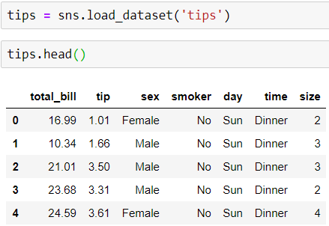
Data
Seaborn comes with built-in data sets!

Slide 5
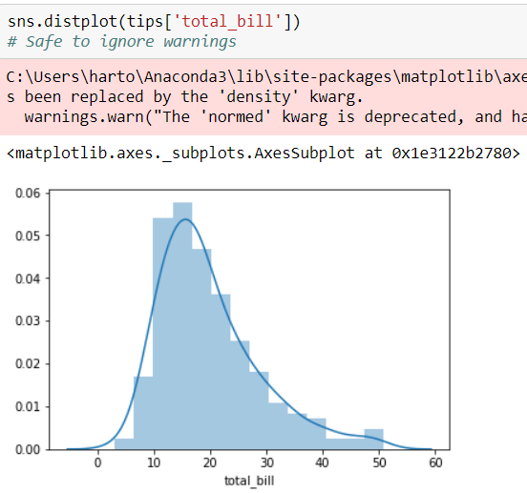
distplot
The distplot shows the distribution of a univariate set of observations.

Slide 6
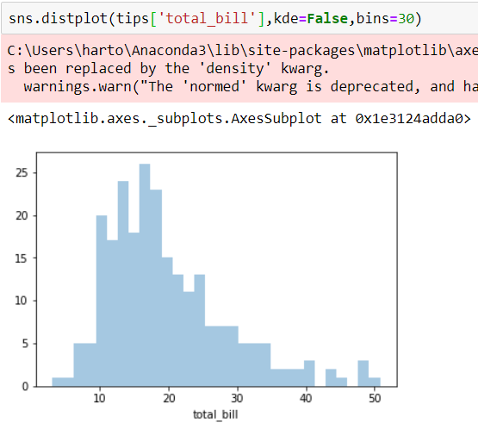
To remove the kde layer and just have the histogram use:

Slide 7
jointplot
jointplot() allows you to basically match up two distplots for bivariate data. With your choice of what kind parameter to compare with:
“scatter”
“reg”
“resid”
“kde”
“hex”

Slide 8
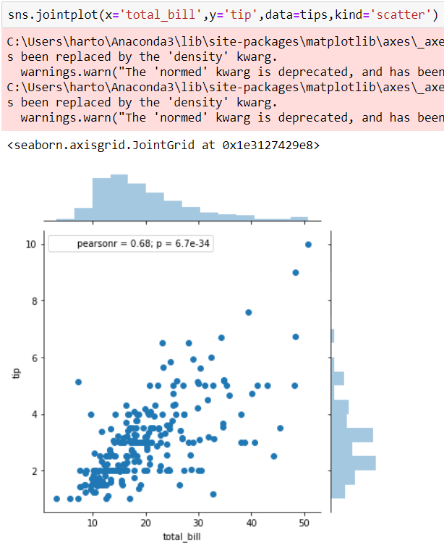

Slide 9
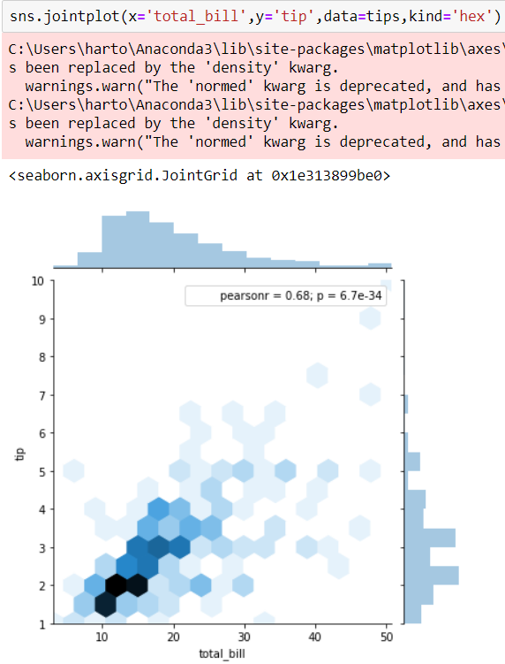

Slide 10
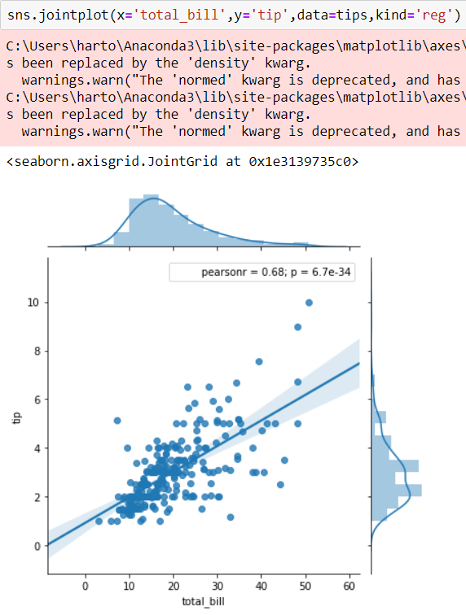

Slide 11
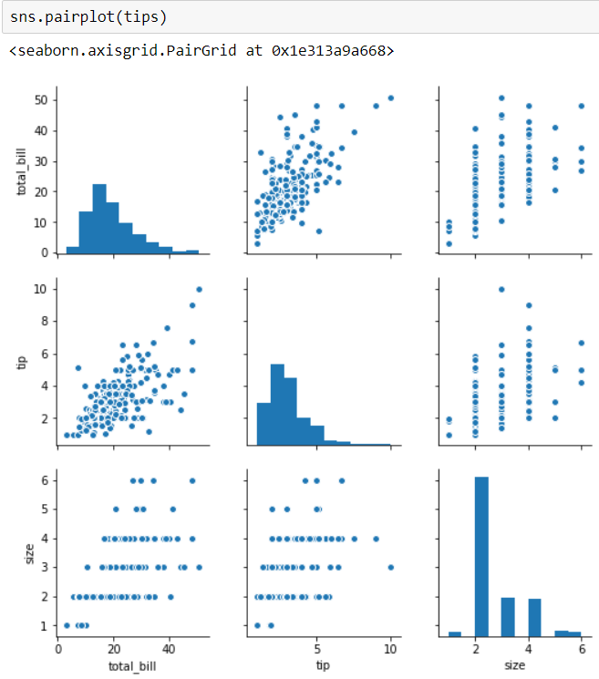
pairplot
pairplot will plot pairwise relationships across an entire dataframe (for the numerical columns) and supports a color hue argument (for categorical columns).

Slide 12
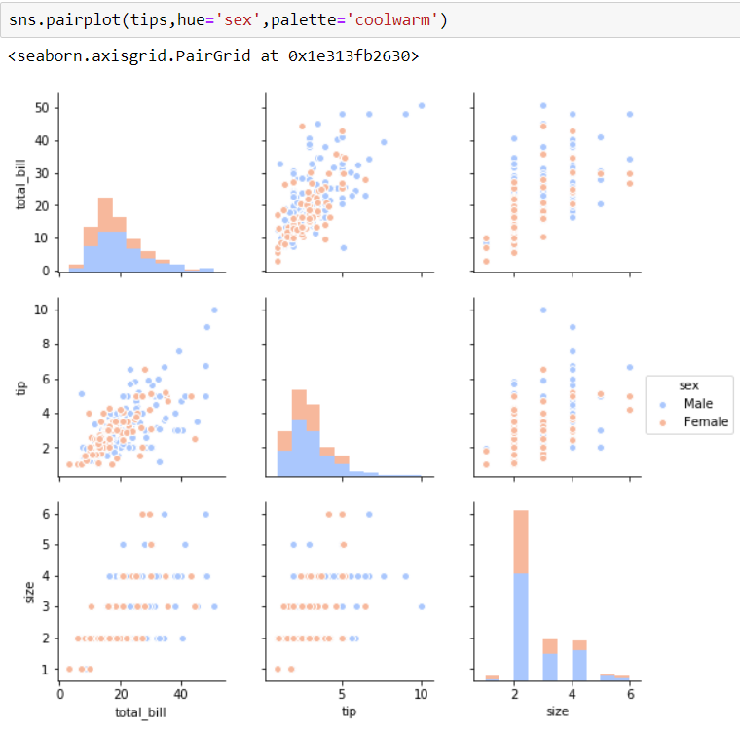

Slide 13
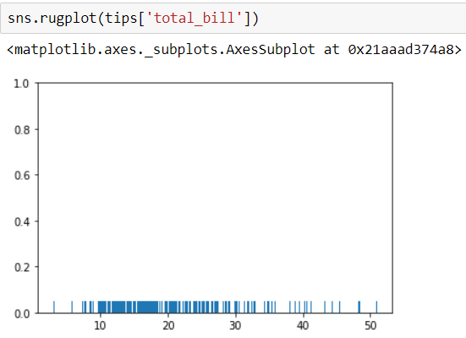
rugplot
rugplots are actually a very simple concept, they just draw a dash mark for every point on a univariate distribution. They are the building block of a KDE plot:

